Slide 1

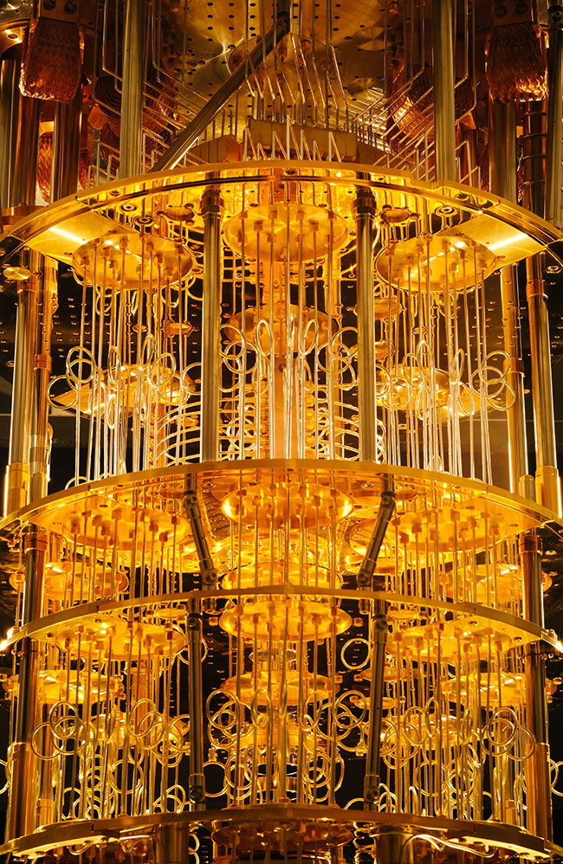
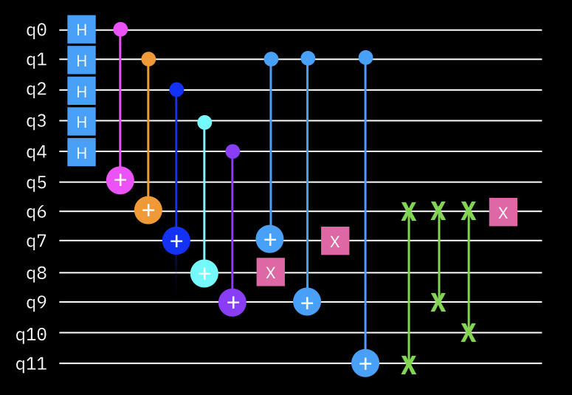
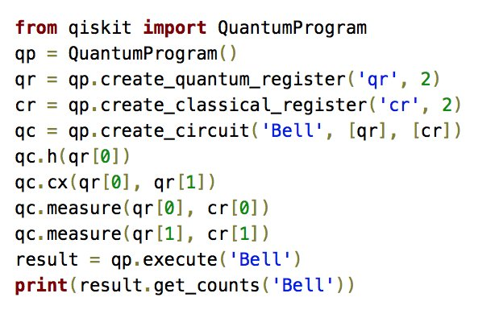
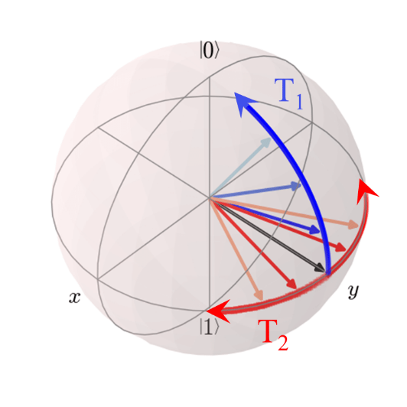

Foundations of
Quantum Computing
(QIS 301)
Dave Biersach
Brookhaven National Laboratory
dbiersach@bnl.gov
Problem Set #1

Slide 2
Open temperature_converter.py
Fix the code to calculate the correct Celsius temperature for a given Fahrenheit temperature
Display values between -44°F and 216°F inclusive
Your code should increment the temperature in steps of 4°F
Make the output look nice: display both the Fahrenheit and Celsius temperatures in right justified columns, with two digits to the right of the decimal in each column
The research problem your scientist wants you to solve:
What is the one temperate that is the same
in both Fahrenheit and Celsius?

Slide 3
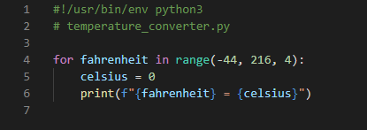
Edit temperature_converter.py
①
②
③
Your code should do exactly what your scientist requested!

Slide 4
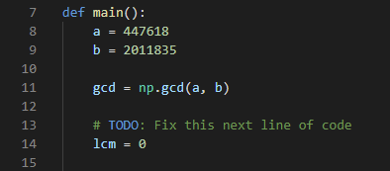
Edit lcm_gcd.py
Calculate the lowest common multiple (LCM) of two integers a & b using only basic arithmetic operators - no looping constructs
You may leverage the Numpy greatest common divisor (GCD) function

Slide 5
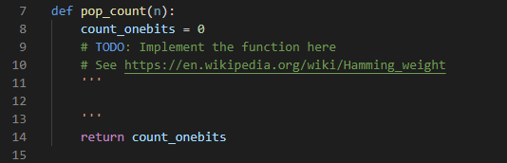
Edit hamming_weight.py
Calculate the Base 2 Hamming Weight of a given natural number
You must write the correct code to find the population count for the passed in variable n and return that count in the variable count_onebits

Slide 6
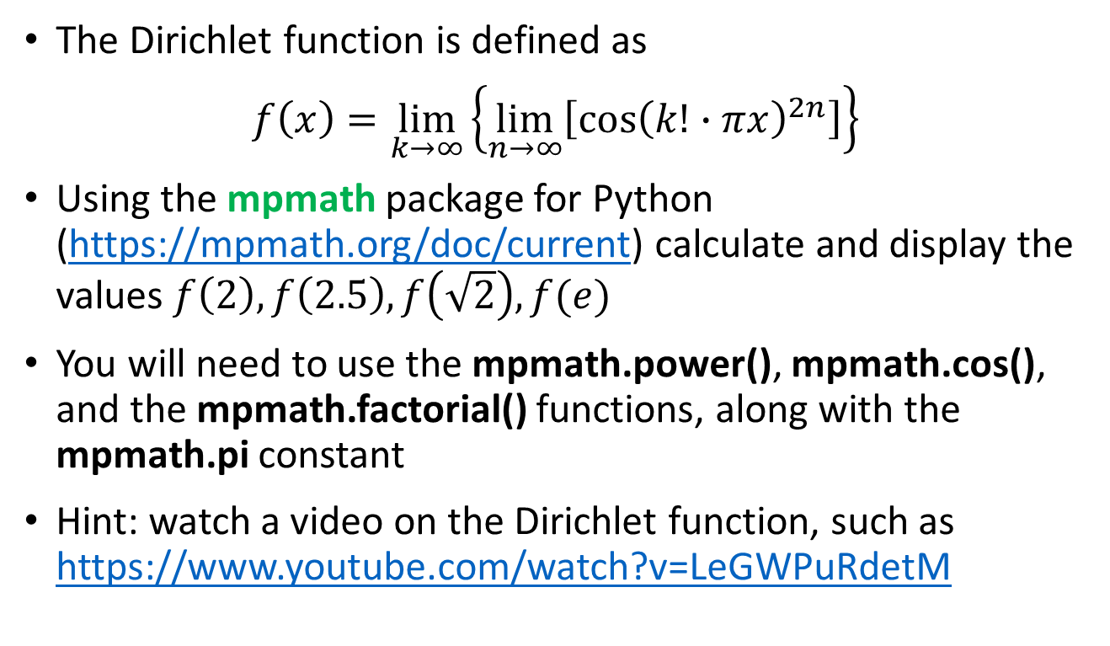
Open diriclet_function.py
The Dirichlet function is defined as
$$f\left(x\right)=\lim_{k→∞}\left\{\lim_{n→∞}\left[{\cos\left(k!∙πx\right)}^{2n}\right]\right\}$$
Using the mpmath package for Python (https://mpmath.org/doc/current) calculate and display the values $f\left(2\right), f\left(2.5\right), f\left(\sqrt{2}\right),f(e)$
You will need to use the mpmath.power(), mpmath.cos(), and the mpmath.factorial() functions, along with the mpmath.pi constant
Hint: watch a video on the Dirichlet function, such as https://www.youtube.com/watch?v=LeGWPuRdetM

Slide 7
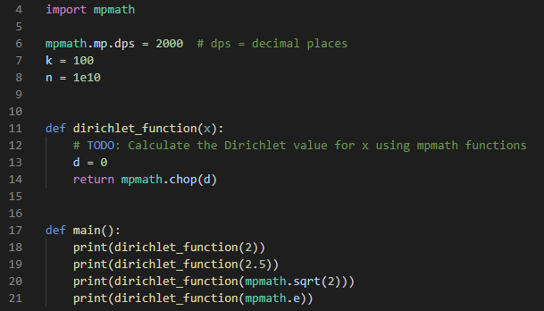
Edit Dirichlet_function.py
Instead of calculating limits, use these fixed values for k and n

Slide 8
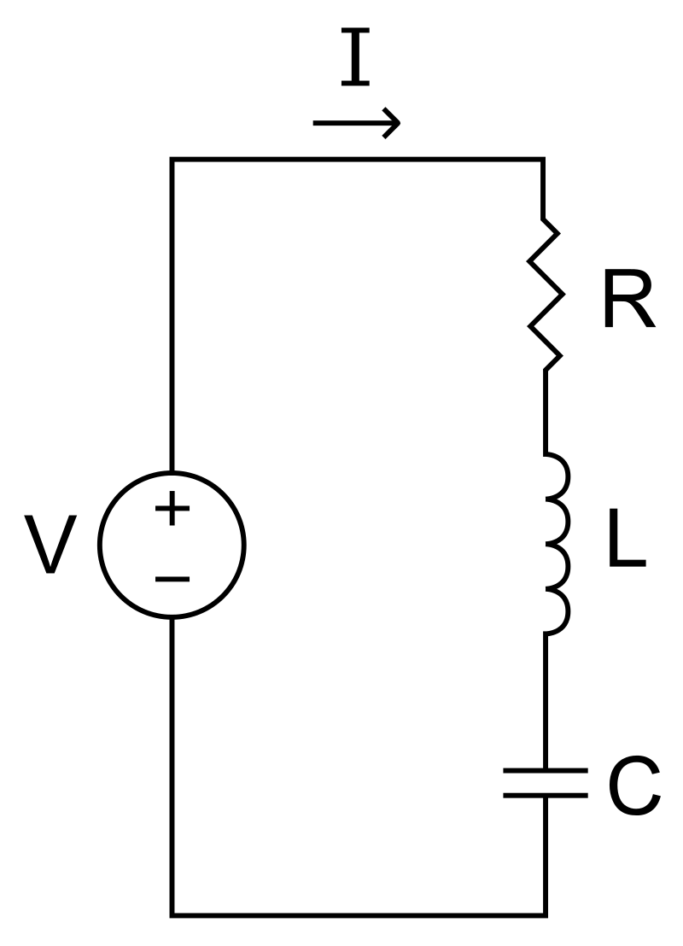
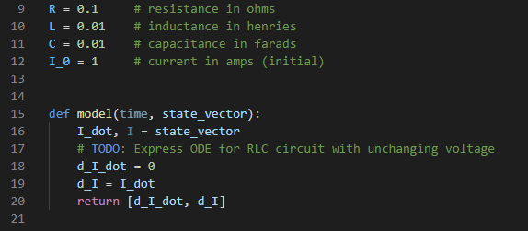

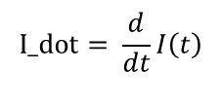
Open rlc_circuit.py
Graph the current (I) over time in an RLC circuit with unchanging voltage
Use SciPy to estimate the 2nd order homogenous ODE out to 1 second
$$I_dot= \frac{d}{dt}I\left(t\right)$$
$$\frac{d^{2}}{{dt}^{2}}I\left(t\right)=−\frac{R}{L}\frac{d}{dt}I\left(t\right)−\frac{1}{LC}I(t)$$

Slide 9
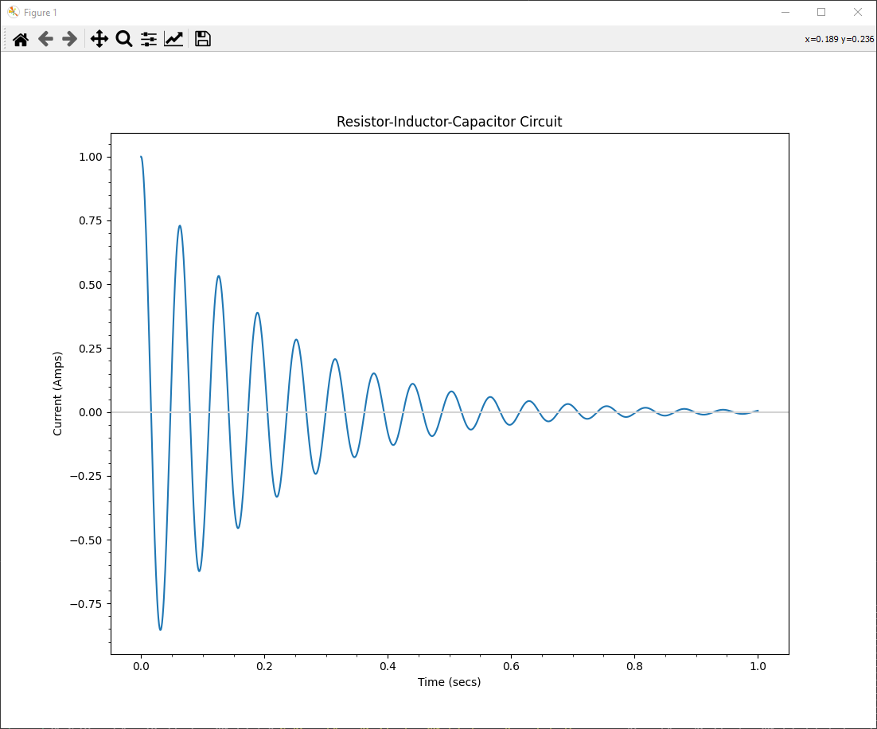
Run rlc_circuit.py
This is the approved solution

